Slide 2
UNPUNISHED
ABOUT THE DOCUMENTARY FILM
TITLE
UNPUNISHED: THE RONALD GREENE MURDER/COVER-UP
EXPOSING INJUSTICE, DEMANDING ACCOUNTABILITY
SUMMARY
Unpunished: The Ronald Greene Murder/Cover-Up" is a gripping documentary that delves into the harrowing case of Ronald Greene, a Black man whose tragic death at the hands of 6 White Louisiana State Troopers sparked national outrage. Through powerful storytelling, compelling interviews, and raw footage, the documentary shines a spotlight on the systemic racism, police brutality, blatant cover-up and corruption that pervade our criminal justice system.
As the truth unfolds, viewers are taken on a journey of discovery, confronting uncomfortable truths and demanding justice for Ronald Greene and countless other victims of police violence.

Slide 3
UNPUNISHED
TIMELINE OF EVENTS
MURDER
COVER UP
INDICTMENTS
JUSTICE
???
INVESTIGATION
WHISTLEBLOWER
Notes:
Suggested timeline could be added after the introduction of the characters to reflect what the documentary will review.

Slide 4
UNPUNISHED
BACKSTORY:
WHO IS RONALD GREENE?
Shortly after midnight on May 10, 2019, State Trooper Dakota DeMoss attempted to pull over Ronald Greene, a 49-year-old African-American barber, for an unspecified traffic violation near Monroe, Louisiana. Greene did not stop and troopers conducted a car chase on rural highways at speeds reaching over 115 mph. At the end the car chase troopers pulled Greene from the car beat him, tased him and pepper sprayed him. Greene died on the scene from his injuries. The coverup began immediately and included troopers turning off their body worn cameras, writing a false report stating that Greene died from a car crash and stating that no camera footage existed.
TBD

Slide 5
UNPUNISHED
NATIONAL ATTENTION ON THE RONALD GREENE CASE

Slide 6
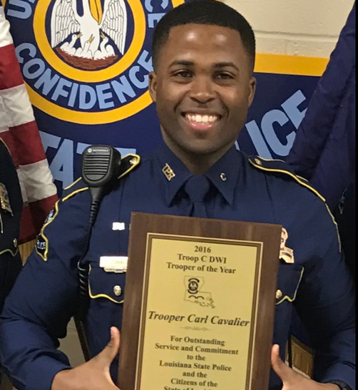
UNPUNISHED
KEY INDIVIDUALS
Ronald Greene
Carl Cavalier
Mona Hardin
Victim
Former Louisiana State Trooper & Whistleblower
Mother of Ronald Greene

Slide 7
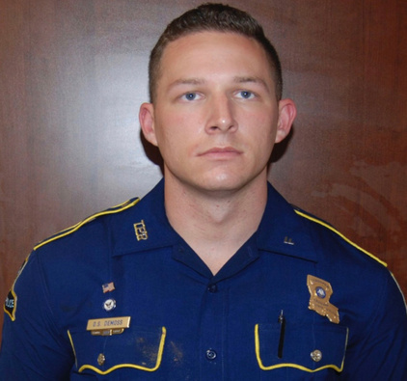
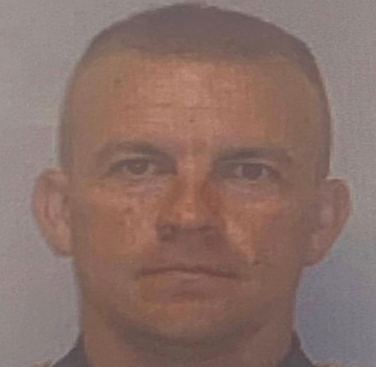
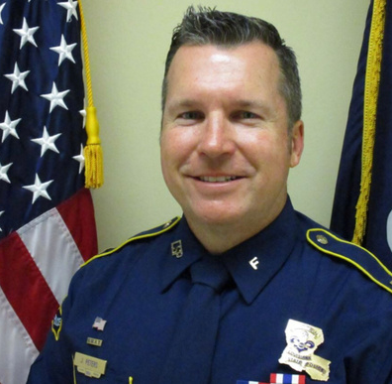
UNPUNISHED
KEY INDIVIDUALS
Pictured below are State Troopers and The Louisiana State Police involved
Chris Hollingsworth
Dakota DeMoss
Kory York
John Peters
Chris Harpin

Slide 8
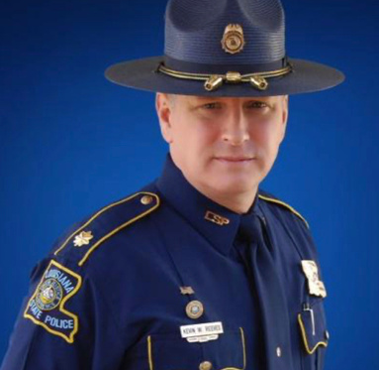
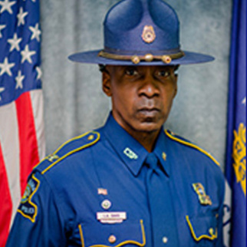
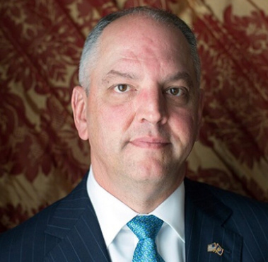
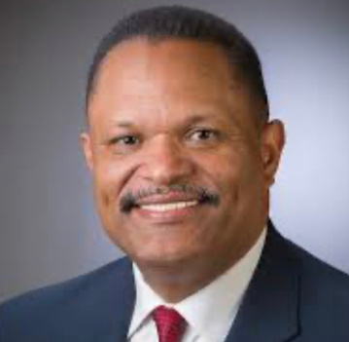
UNPUNISHED
ADDITIONAL INDIVIDUALS
Additional officers and state personnel are involved in this case, and their affiliation will be outlined throughout the documentary

Slide 9
UNPUNISHED
THE PRODUCTION PROCESS

Slide 10
UNPUNISHED
CURRENT STATUS
Target Audience
Key Features
Current Status
Advocates for social justice and racial equality.
Community organizers and activists.
Legal professionals and policymakers.
General audiences seeking thought-provoking and impactful documentaries.
We need to put an industry target in here. (ex. P 35-54. Once it gets a bit further along, we can discuss this)
This documentary is now in its final stages, with all principal photography complete. We have captured high-quality footage in diverse locations to capture the film’s impact.
We are fully prepared for investment and global distribution. After extensive research, filming, and editing, we have completed a compelling narrative that highlights our core themes and key messages.
Exclusive interviews with family members, activists, legal experts, committee hearings and community leaders.
Unprecedented access to previously unreleased evidence and footage.
Insightful commentary on the broader issues of racial injustice and police accountability.

Slide 11
UNPUNISHED
ABOUT OUR TEAM
THE DIRECTOR
CHICO BRYANT
Chico Bryant is a native of Jersey City, NJ. Chico attended New Jersey City University in Jersey City, NJ where he received his Bachelor of Science in Business Administration with a Concentration in Marketing. His first taste of the entertainment industry was in the early 90’s, when he was an unpaid intern at both Uptown MCA Records and Def Jam Records where he served as an Assistant to the (A&R) for Marketing and Promotions. He later moved on to start his own entertainment management company where he managed an array of unsigned talents, including singers, producers and engineers.
Chico always had a love and passion for film and television. He appeared in several independent films. He was an extra for various films, commercials and television shows. With the launch of United Venture Productions, Chico plans to make films that inform, inspire and unite, recognizing that we are stronger together.

Slide 12
UNPUNISHED
ABOUT OUR TEAM
United Venture Productions is powered by a dynamic team of creatives, dedicated to crafting captivating content that resonates with a variety of audiences worldwide. Our team combines expertise in production, storytelling, and innovation to bring ideas and important cultural stories to life.
BILL HAMPTON
ANTHONY LOFTON
FAIN
Executive Producer
Producer/Cinematographer
Producer/Cinematographer
SEAN LINDSAY
SAM WALKER
BRADEN BARTY
Editor
Producer
Producer/Cinematographer

Slide 13
UNPUNISHED
ABOUT OUR TEAM
Together, we seamlessly deliver impactful and memorable stories within the industry.
DR. DELACY DAVIS
CARL CAVALIER
Associate Producer
Associate Producer

Slide 14
UNPUNISHED
FINAL TRAILER
Notes:
Embed full trailer into this presentation page

Slide 15
UNPUNISHED
FOR YOUR CONSIDERATION FOR LICENSING
Genre:
Documentary Film
For inquiries and distribution opportunities, please contact: Chico Bryant
EMAIL
jamesl@unitedventureproductions.com
PHONE NUMBER
732-770-7200
www.unitedventureproductions.com
Notes:
Consider disclaimer page.

